Slide 1
API TESTING
Women of security
@WoSECTweets

Slide 2
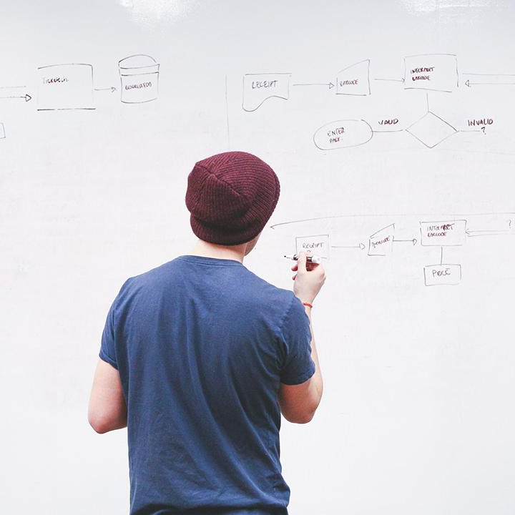
HELLO!
I am Judy Ngure
I am here because I love Application security and Women of security
@Codebash

Slide 3
What will we be discussing today?
API 101
Finding Endpoints
Finding Docs
Finding Sample Calls
Finding Keys

Slide 4
API-101

Slide 5
Application Programming Interface
APIs in a nutshell are services that help you get seem less connection. Give examples
APIs connect our most intimate and sensitive data

Slide 6
API EXAMPLES
Google
code
WEBSITE
e.g Medium
code
Login using your google account
Login
Someone elses code used for your website

Slide 7
For this to be possible the developer would need to install a sattelite.
(Ridiculous right)
MOBILE APP
Has weather updates
IBM has done this already
I want an API
Here is the API key

Slide 8
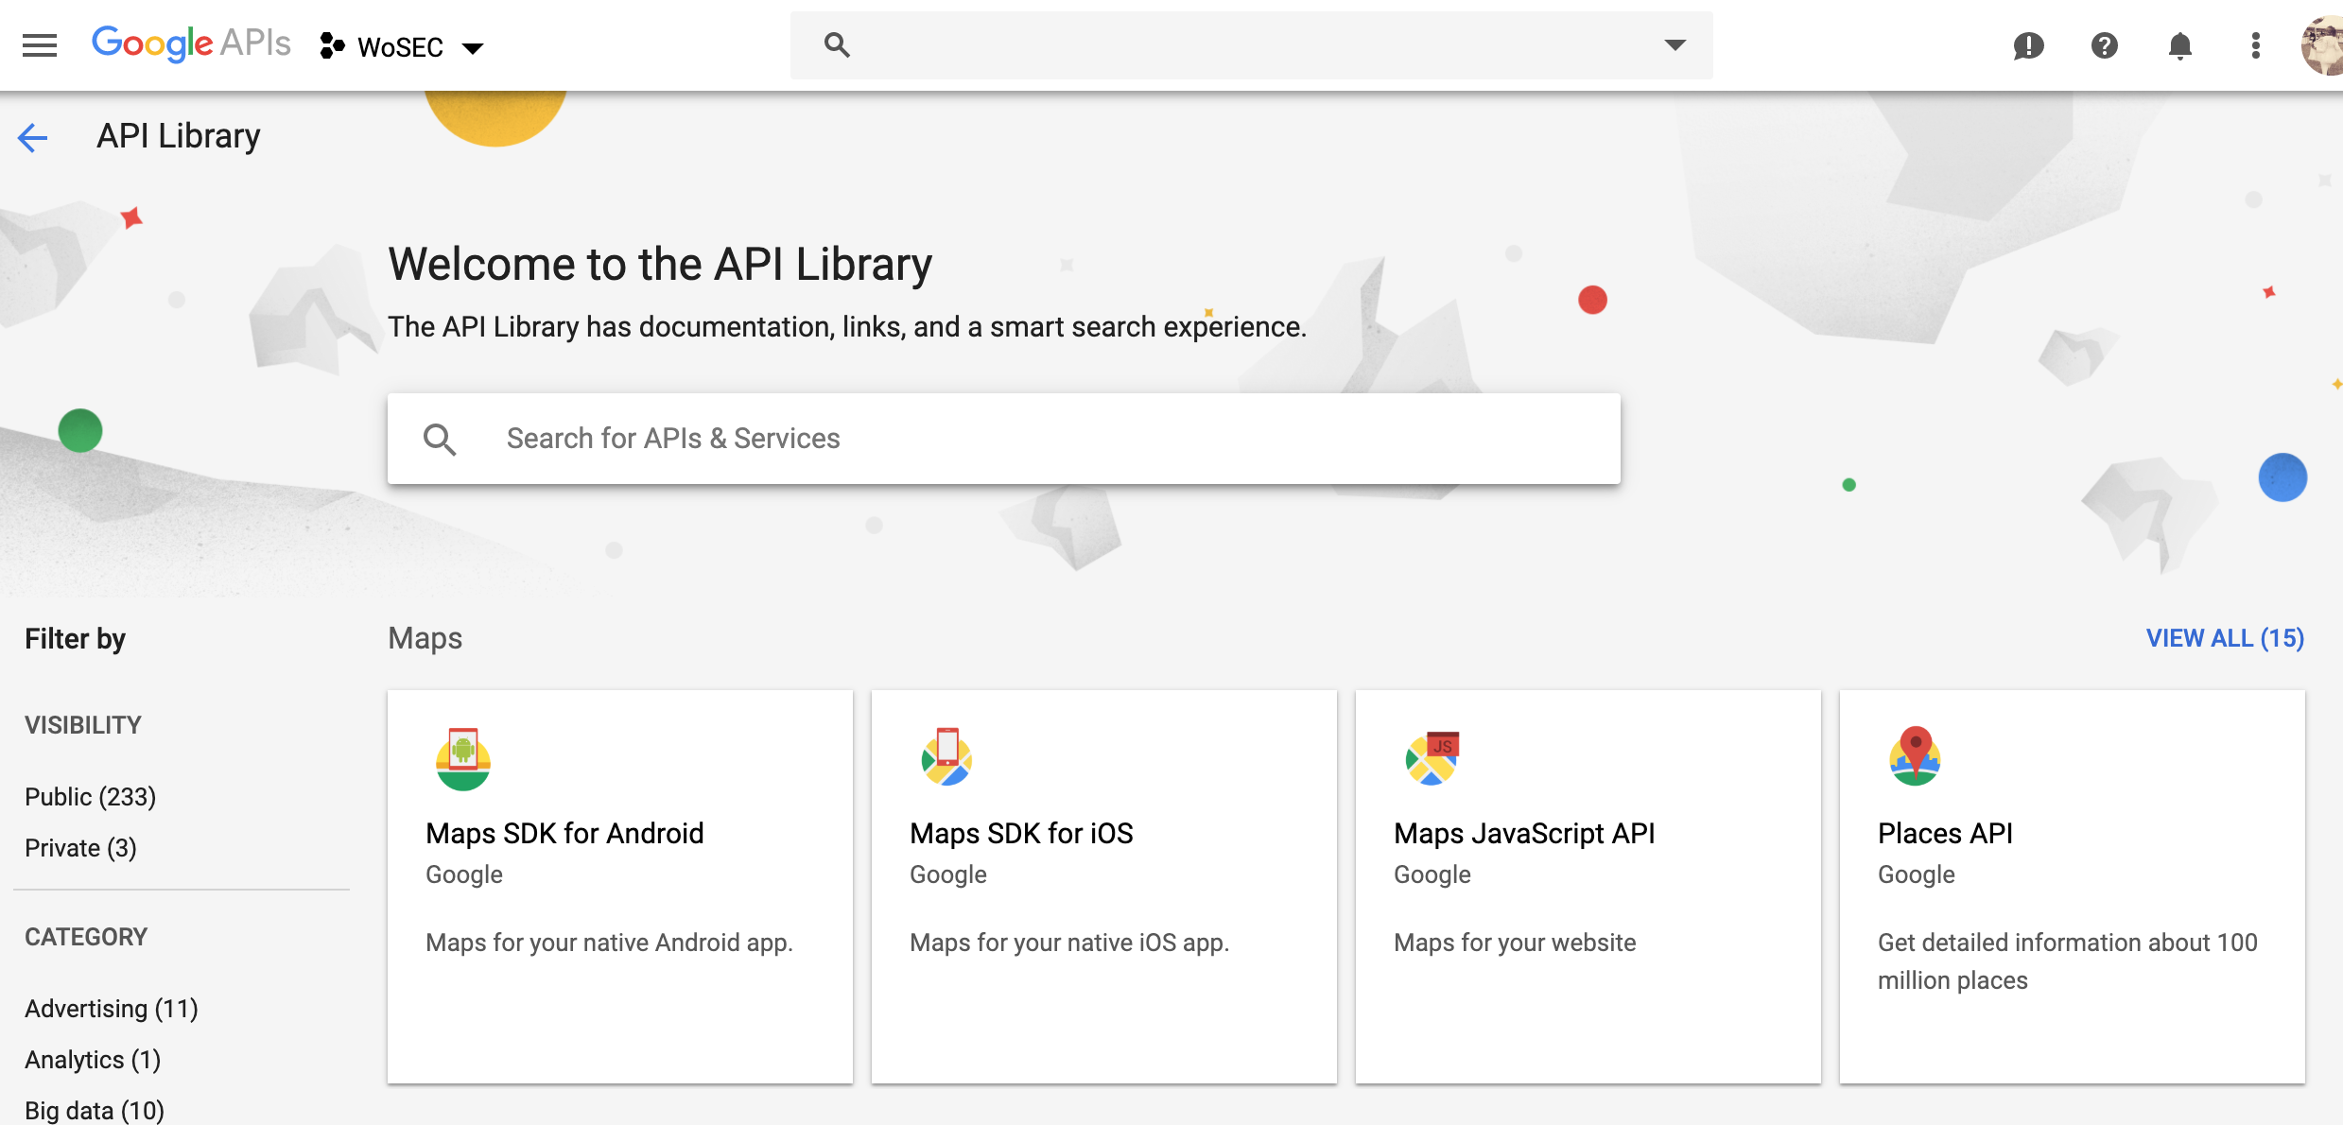

Slide 9
Types Of APIs
SOAP
RESTful
Public APIs
Private APIs
SaaS APIs,
APIs performing mobile back-end functions

Slide 10
API KEYS
Authenticate calls to the API to registered users only
Track who is making the requests
Track usage of the API
Block or throttle requesters who exceed the rate limits
Apply different permission levels to different users

Slide 11
RESTful APIS
Data for Restful API is Sent as JSON, XML and HTML
Uses HTTP methods to communicate
GET
POST
PUT
PATCH

Slide 12
GET ENDPOINTS
Show traffic on burp
Endpoints are just URLS to the API
/api/
/v1/
/V1.0/
/v1.1/
/api/v1/
/api/v2/

Slide 13
SPRING BOOT APIs
ENDPOINTS
/actuator/
/health/
/trace/
/logfile/
/Metrics/
/headdump/

Slide 14
Finding DOCS
This mostly works for Public APIS
/api-docs/
/application.wadl/
/doc/
/docs/

Slide 15
Finding sample calls
Prompt errors and see the error message shown
Brute force parameter
Analyze Code

Slide 16
DEMO
Burp suite
Postman
Parameth
Pixi (on docker)
Truffle hog

Slide 17
DEMO 1 (Finding Ednpoints)
DEMO 2: API calls
DEMO 3: API hacks

Slide 18
THANKS!
Any questions?
You can find me at
@judy_infosec

